Slide 1
Example: build a better BannerWeb
Professors offer classes, students register, get grades
What are some questions we (students or faculty) could ask of this database system?
Find my GPA.
…

Slide 2
Example: build a better BannerWeb
Why are security, concurrency, and atomicity important here?

Slide 3

Solution 1
Advantages?
Disadvantages?

Slide 4
Solution 2
Text files and Python/Java programs

Slide 5

Solution 3
Let's use CSV: (comma-separated values)
Hermione,Granger,R123,Potions,A
Draco,Malfoy,R111,Potions,B
Harry,Potter,R234,Potions,A
Ronald,Weasley,R345,Potions,C

Slide 6
What's the issue here?
Hermione,Granger,R123,Potions,A
Draco,Malfoy,R111,Potions,B
Harry,Potter,R234,Potions,A
Ronald,Weasley,R345,Potions,C
Harry,Potter,R234,Herbology,B
Hermione,Granger,R123,Herbology,A

Slide 7
File 1:
Hermione,Granger,R12
Draco,Malfoy,R111
Harry,Potter,R234
Ronald,Weasley,R345
File 2:
R123,Potions,A
R111,Potions,B
R234,Potions,A
R345,Potions,C
R234,Herbology,B
R123,Herbology,A

Slide 8
Problems
Inconvenient – need to know Python/Java to get at data!
Redundancy/inconsistency
Integrity problems
Atomicity problems
Concurrent access problems
Security problems

Slide 9
Why are there problems?
Two main reasons:
The description of how the files are laid out is buried within the Python/Java code itself (if it's documented at all)
There is no support for transactions (supporting concurrency, atomicity, integrity, and recovery)
DBMSs handle exactly these two problems.

Slide 10
Relational database systems
Edgar F. Codd was a researcher at IBM who conceived a new way of organizing data based on the mathematical concept of a relation. (1970)
Relation: a set of ordered tuples (oh, no, CS172 stuff…)

Slide 11
Highlights of RDBMS
(R)DBMS = relational database management system.
Data is stored in relations, which resemble tables:
Underlying data structures are more complicated.
First | Last | Course | Grade
Hermione | Granger | Potions | A
Draco | Malfoy | Potions | B
Harry | Potter | Potions | A
Ronald | Weasley | Potions | C

Slide 12
Highlights of RDBMS
Users issue queries to the DBMS, which are handled by the query processor.
Behind the scenes: query optimizer handles all the details of figuring out the most efficient way to answer the query, which might involve combining multiple tables, sorting the data, selecting only a subset of it, ...
The transaction manager handles all the details of atomicity and concurrency.

Slide 13
Data Models
A way of describing data.
Better: a description of how to conceptually structure the data, what operations are possible on the data, and any constraints on the data.
Structure: how we view the data abstractly
Operations: what is possible to do with the data?
Constraints: how can we control what data is legal and what is not?

Slide 14
Relational model
First | Last | Course | Grade
Hermione | Granger | Potions | A
Draco | Malfoy | Potions | B
Harry | Potter | Potions | A
Ronald | Weasley | Potions | C
Structure: relation (table)
Operations: relational algebra (select certain rows, certain columns, where properties are true/false, also combine multiple tables together to answer more complicated questions), (SQL)
Constraints: can enforce restrictions like Grade must be in the set {A, B, C, D, F}

Slide 15
Other models
Semi-structured: data that is still “structured” but not in relational format.
XML, JSON
Object databases, or object-relational
Graph databases
NoSQL, NewSQL (document databases, key-value)

Slide 16
Semi-structured model
Structure: Trees or graphs
e.g., XML
Operations: Follow paths in the implied tree from one element to another.
e.g., XQuery
Constraints: can constrain data types, possible values, etc.
e.g., DTDs (document type definition), XML Schema

Slide 17
Object-relational
Similar to relational, but
Values in a table can have their own structure, rather than being simple strings or ints.
Relations can have associated methods.

Slide 18
NoSQL, NewSQL
Lots of different types, but main idea is there is no separate schema definition.
Main reasons for using: conceptually simpler, easy to replicate across clusters of machines, can be faster than relational.
Drawbacks: harder to write queries, lack of "joins," possible lack of consistency.

Slide 19
Relational model is most common
Simple: built around a single concept for modeling data: the relation or table.
A relational database is a collection of relations.
Each relation is a table with rows and columns.
An RDBMS can manage many databases at once.
Supports high-level programming language (SQL)
Limited but useful set of operations.
Has elegant mathematical theory behind it.

Slide 20
Relation Terminology
Relation == 2D table
Attribute == column name
Tuple == row (not the header row)
Database == collection of relations
First | Last | Course | Grade
Hermione | Granger | Potions | A
Draco | Malfoy | Potions | B
Harry | Potter | Potions | A
Ronald | Weasley | Potions | C

Slide 21
Relation Terminology
A relation includes two parts:
The relation schema defines the column headings of the table (attribute names)
The relation instance defines the data rows (tuples, rows, or records) of the table.
First | Last | Course | Grade
Hermione | Granger | Potions | A
Draco | Malfoy | Potions | B
Harry | Potter | Potions | A
Ronald | Weasley | Potions | C
Notes:
Schema is kind of like defining a struct in C++. You define what members the class has and what their data types are.
Each row in a DB is an instance of the class, so an instance of the entire relation is a collection of these rows.

Slide 22
Schema
A schema is written as the name of the relation followed by a parenthesized list of attributes.
Grades(First, Last, Course, Grade)
A relational database schema is the set of schemas for all the relations in a DB.
First | Last | Course | Grade
Hermione | Granger | Potions | A
Draco | Malfoy | Potions | B
Harry | Potter | Potions | A
Ronald | Weasley | Potions | C

Slide 23
Tuples
A tuple is a row of a relation.
Notation: (Draco, Malfoy, Potions, B)
First | Last | Course | Grade
Hermione | Granger | Potions | A
Draco | Malfoy | Potions | B
Harry | Potter | Potions | A
Ronald | Weasley | Potions | C

Slide 24
Domains
A relational DB requires that every component of a row (tuple) have a specific elementary data type, or domain.
string, int, float, date, time (no complicated objects!)
Grades(First:string, Last:string, Course:string, Grade:char)

Slide 25
Equivalent representations of a relation
First | Last | Course | Grade
Hermione | Granger | Potions | A
Draco | Malfoy | Potions | B
Harry | Potter | Potions | A
Ronald | Weasley | Potions | C
Grades(First, Last, Course, Grade)
Relation is a set of tuples, not a list.
Attributes in a schema are a set as well.
However, the schema specifies a "standard" order for the attributes.
How many equivalent representations are there for a relation with m attributes and n tuples?

Slide 26

Degree and cardinality
First | Last | Course | Grade
Hermione | Granger | Potions | A
Draco | Malfoy | Potions | B
Harry | Potter | Potions | A
Ronald | Weasley | Potions | C
Degree/arity of a relation is the number of attributes in a relation.
Cardinality is the number of tuples in a relation.

Slide 27

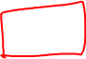
Keys to a good relation(ship)

Slide 28


Keys to a good relation(ship)
Relation

Slide 29
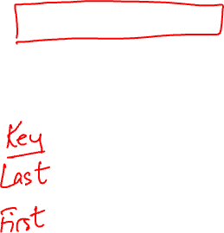
Keys of a relation
Keys are a kind of integrity constraint.
A set of attributes K forms a key for a relation R if
no pair of tuples in an instance of R may have the same values for all attributes of K.
First | Last | Course | Grade
Hermione | Granger | Potions | A
Draco | Malfoy | Potions | B
Harry | Potter | Potions | A
Ronald | Weasley | Potions | C
Grades(First, Last, Course, Grade)
Notes:
SEE NOTES

Slide 30
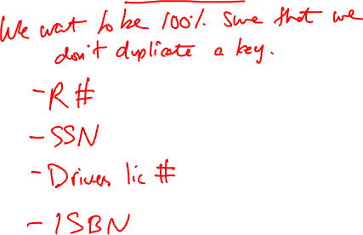
Artificial Keys

Slide 31
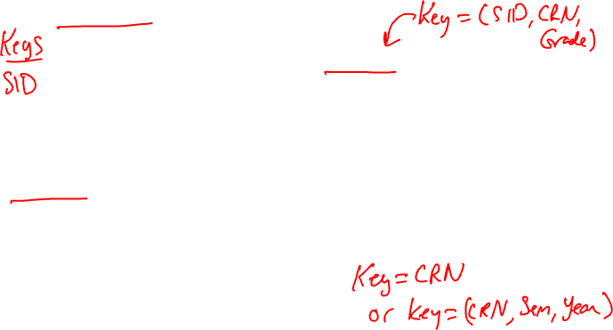
Keys of a relation
Keys help associate tuples in different relations.
Students(SID, First, Last)
SID | First | Last
123 | Hermione | Granger
111 | Draco | Malfoy
234 | Harry | Potter
345 | Ronald | Weasley
Grades(SID, CRN, Grade)
SID | CRN | Grade
123 | 777 | A
111 | 777 | B
234 | 777 | A
345 | 777 | C
Courses(CRN, Name, Sem., Year)
CRN | Name | Semester | Year
777 | Potions | Fall | 1997
888 | Potions | Spring | 1997
999 | Transfiguration | Fall | 1996
789 | Transfiguration | Spring | 1996
Notes:
Often, many real world databases create artificial keys, because often we want to be 100% sure we will never have any duplicates in combinations of attributes.
What are the keys in these relations? Key for student table = SID. Key(courses) = CRN or maybe <CRN,Sem,Year> Key(grades)=all attribs.

Slide 32
Example
Let's expand these relations to handle the kinds of things you'd like to see in BannerWeb.
Keep track of students, professors, courses, who teaches what, enrollments, pre-requisites, grades, departments & their chairs.
Only one chair per department.
Student cannot enroll in multiple copies of the same course in one semester.
Other constraints that are logical.
Notes:
write schema for past 3 tables on board
develop new schemas
Profs(??) develop schema:
If CRN is always unique, where do we store who teaches a course? (in courses tbl)
If CRN is not unique, where do we store who teaches a course? (in sep new tbl)

Slide 33
Keep track of students, professors, courses, who teaches what, enrollments, pre-requisites, grades, departments & their chairs.
Only one chair per department.
Student cannot enroll in multiple copies of the same course in one semester.
Other constraints that are logical.
So far: Students(SID, First, Last)
Courses(CRN, Name, Sem., Year)
Grades(SID, CRN, Grade)

